Slide 1
ModelAngelo: Automated Model Building in Cryo-EM Maps
林思涵
2023/01/09

Slide 2
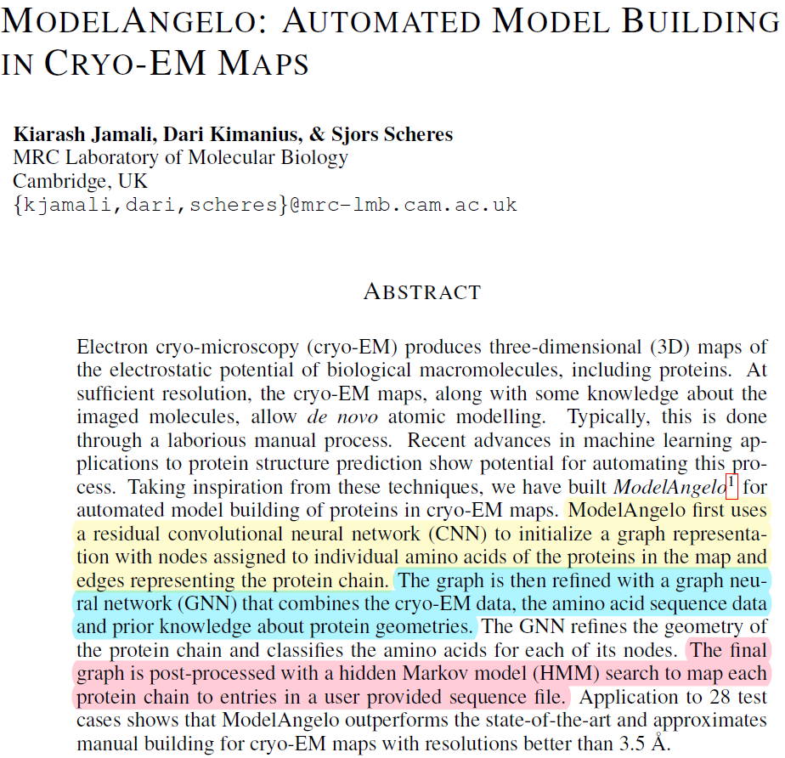
ModelAngelo
CNN
Residue Segmentation
GNN
All-Atom Modelling
HMM
Post-processed

Slide 3
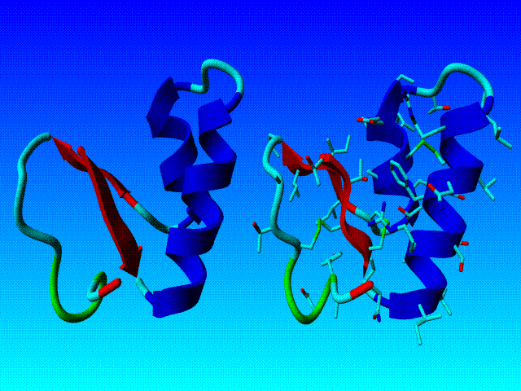
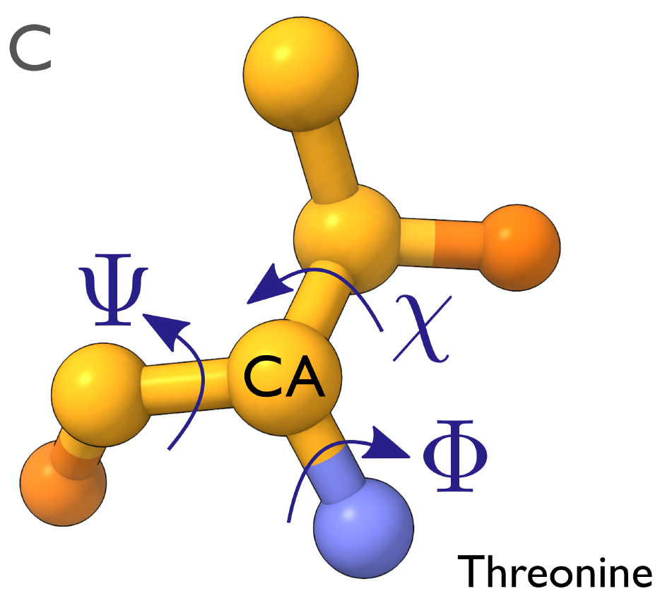
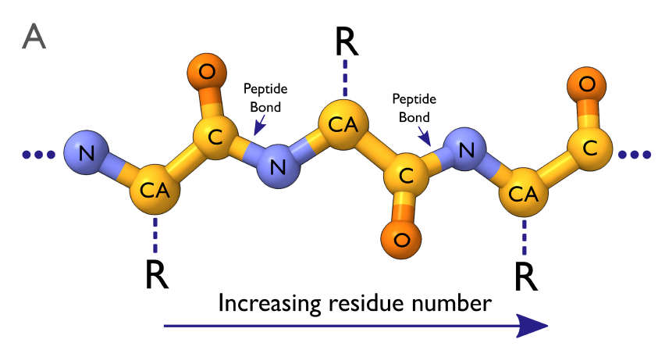
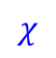






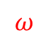
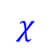
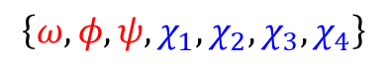
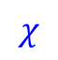
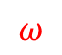
Background Knowledge
Backbone
$$\left\{ω,φ,ψ,χ_{1},χ_{2},χ_{3},χ_{4}\right\}$$
Torsion Angle
$$χ$$
$$φ$$
$$φ$$
$$ψ$$
$$φ$$
$$ψ$$
$$ω$$
$$ω$$
$$ψ$$
$$χ$$
$$χ$$

Slide 4
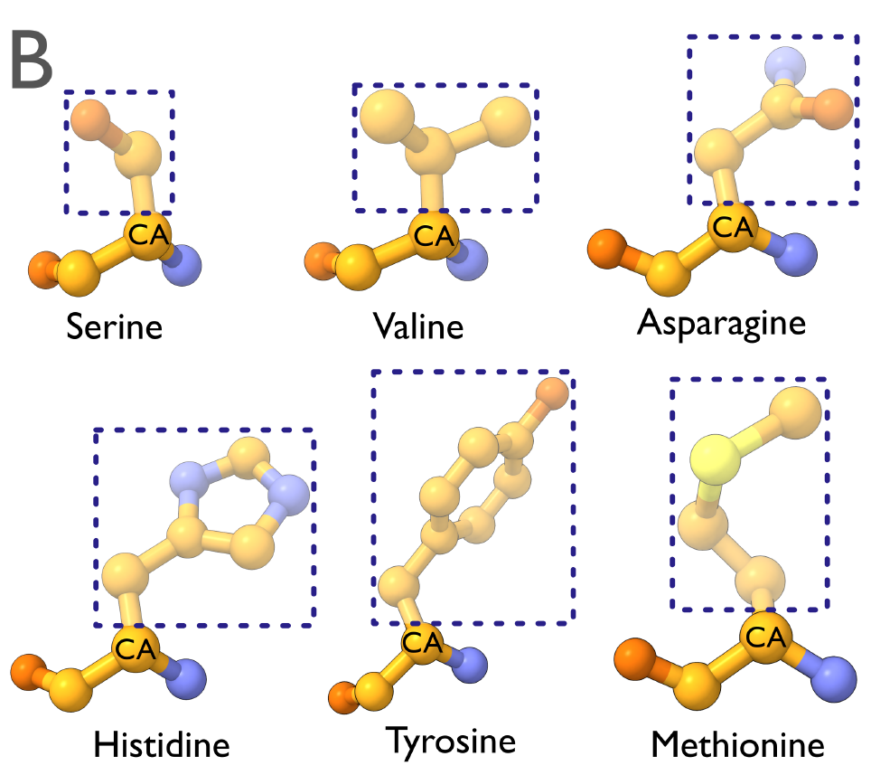
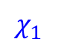

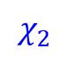
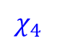
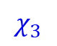
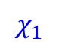
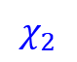
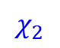

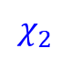
Background Knowledge
Torsion Angle
$$\left\{ω,φ,ψ,χ_{1},χ_{2},χ_{3},χ_{4}\right\}$$
Residue (Side chain)
Backbone
Amino-acid (aatype:20)
$$χ_{2}$$
$$χ_{2}$$
$$χ$$
$$χ_{1}$$
$$φ$$
$$φ$$
$$ψ$$
$$φ$$
$$ψ$$
$$ω$$
$$ω$$
$$ψ$$
$$χ_{1}$$
$$χ_{1}$$
$$χ$$
$$χ$$
$$χ_{2}$$
$$χ_{2}$$
$$χ_{3}$$
$$χ_{4}$$

Slide 5
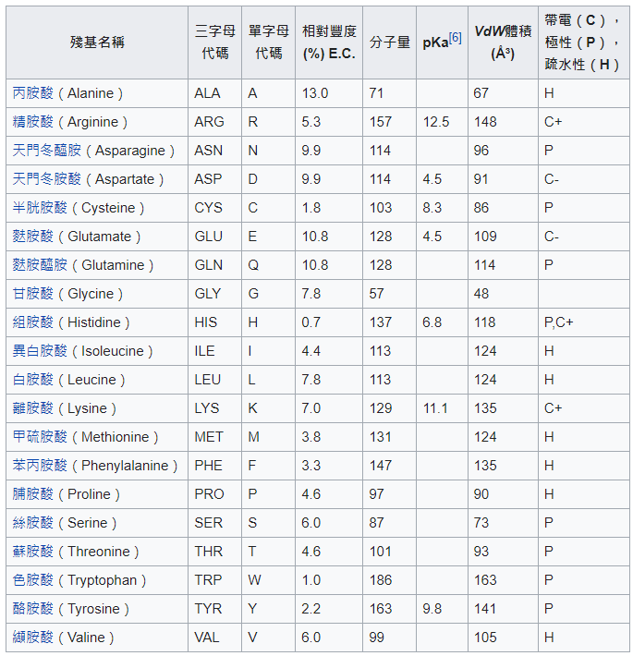
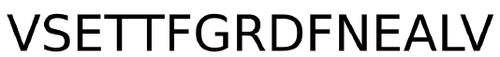

Slide 6
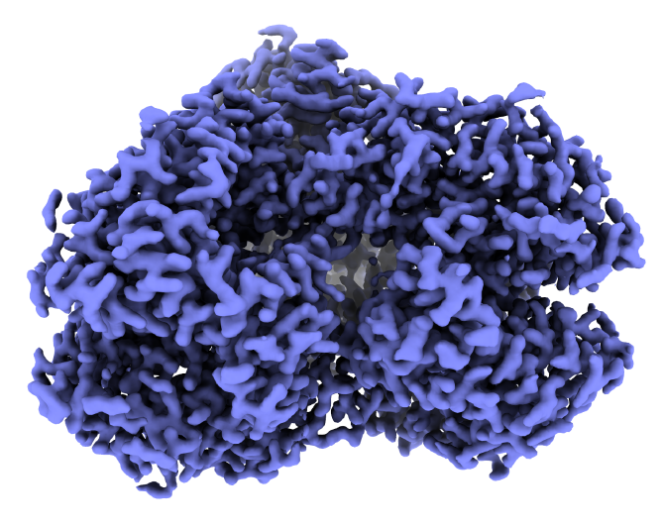
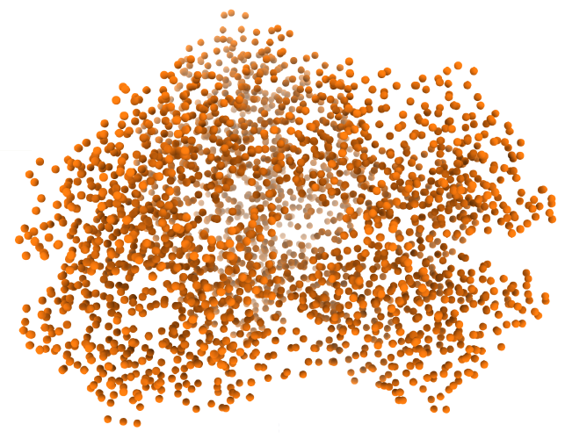
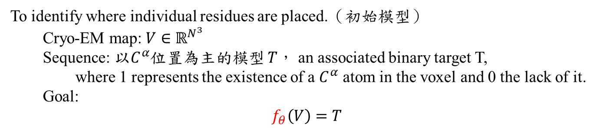
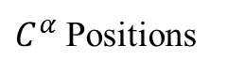
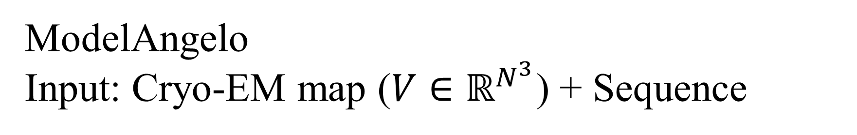
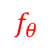
ModelAngelo Input: Cryo-EM map ($V∈ℝ^{N^{3}}$) + Sequence
CNN
Residue Segmentation
To identify where individual residues are placed.（初始模型）
Cryo-EM map: $V∈ℝ^{N^{3}}$
Sequence: 以$C^{α}$位置為主的模型 $T$， an associated binary target T,
where 1 represents the existence of a $C^{α}$ atom in the voxel and 0 the lack of it.
Goal:
$$f_{θ}\left(V\right)=T$$
GNN
All-Atom Modelling
HMM
Post-processed
$$f_{θ}$$
Cryo-EM map
$C^{α}$ Positions

Slide 7
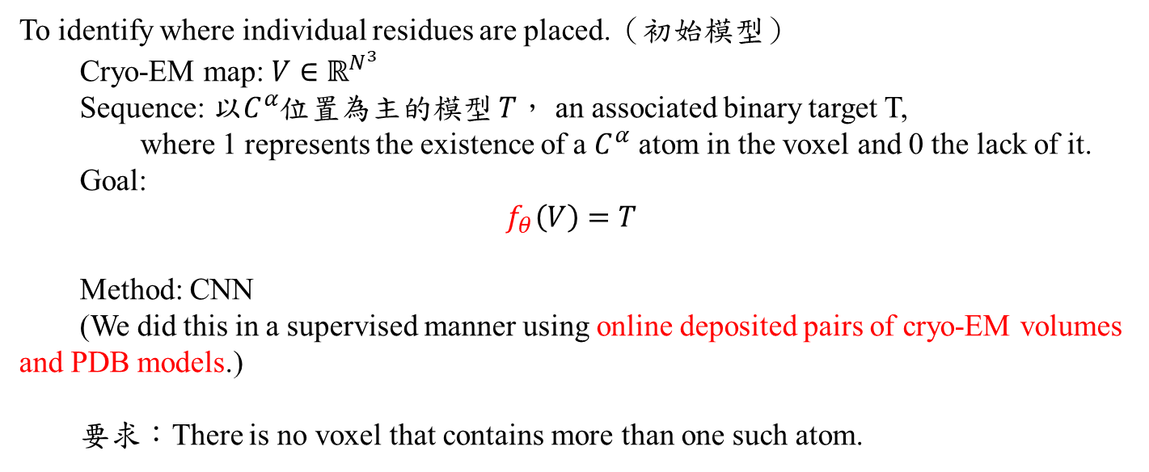
ModelAngelo Input: Cryo-EM map ($V∈ℝ^{N^{3}}$) + Sequence
CNN
Residue Segmentation
To identify where individual residues are placed.（初始模型）
Cryo-EM map: $V∈ℝ^{N^{3}}$
Sequence: 以$C^{α}$位置為主的模型 $T$， an associated binary target T,
where 1 represents the existence of a $C^{α}$ atom in the voxel and 0 the lack of it.
Goal:
$$f_{θ}\left(V\right)=T$$
Method: CNN
(We did this in a supervised manner using online deposited pairs of cryo-EM volumes and PDB models.)
要求：There is no voxel that contains more than one such atom.
GNN
All-Atom Modelling
HMM
Post-processed

Slide 8
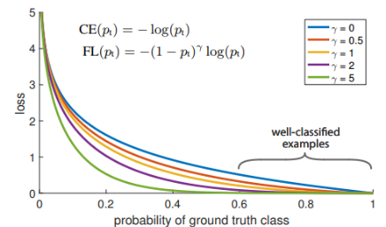
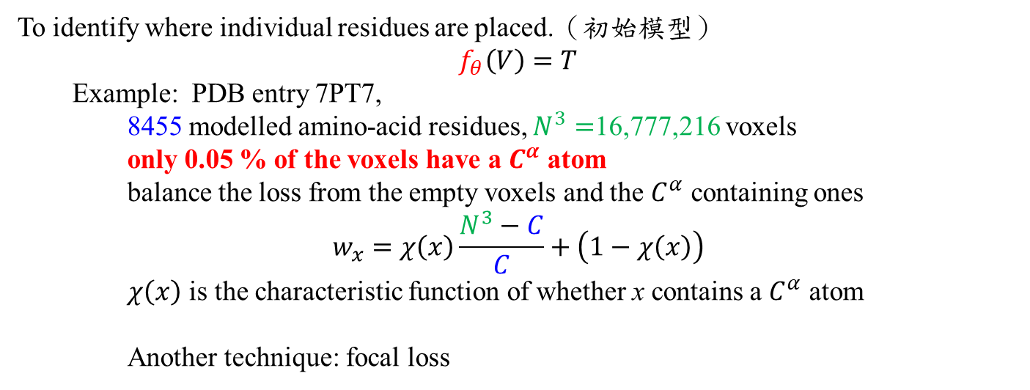
ModelAngelo Input: Cryo-EM map ($V∈ℝ^{N^{3}}$) + Sequence
CNN
Residue Segmentation
To identify where individual residues are placed.（初始模型）
$$f_{θ}\left(V\right)=T$$
Example: PDB entry 7PT7,
8455 modelled amino-acid residues, $N^{3}=$16,777,216 voxels
only 0.05 % of the voxels have a $C^{α}$ atom
balance the loss from the empty voxels and the $C^{α}$ containing ones
$$w_{x}=χ\left(x\right)\frac{N^{3}−C}{C}+\left(1−χ\left(x\right)\right)$$
$χ\left(x\right)$ is the characteristic function of whether x contains a $C^{α}$ atom
Another technique: focal loss
GNN
All-Atom Modelling
HMM
Post-processed

Slide 9
ModelAngelo Input: Cryo-EM map ($V∈ℝ^{N^{3}}$) + Sequence
CNN
Residue Segmentation
GNN
All-Atom Modelling
Cryo-EM Attention module + Sequence Attention module + Spatial Invariant Point
Attention module
HMM
Post-processed

Slide 10
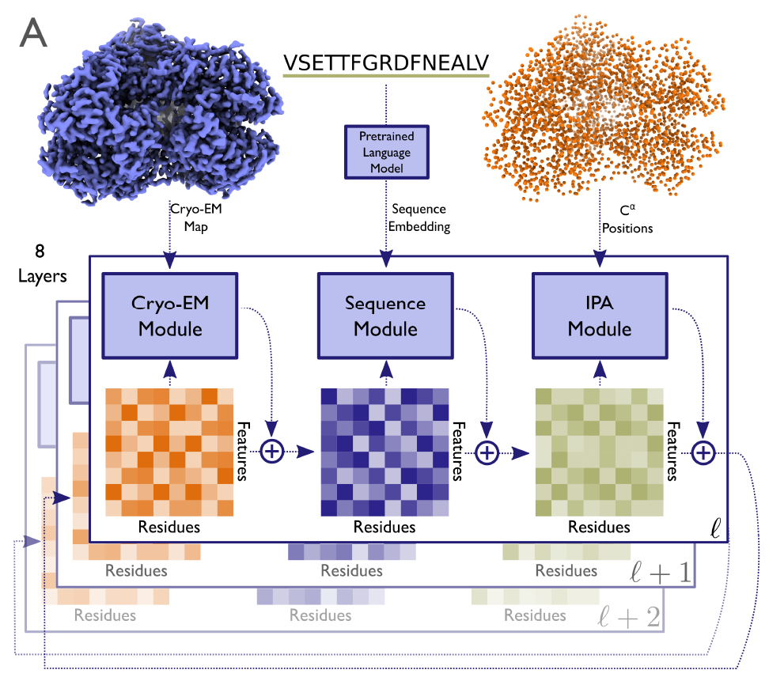
ModelAngelo Input: Cryo-EM map ($V∈ℝ^{N^{3}}$) + Sequence
CNN
Residue Segmentation
Cryo-EM Attention module + Sequence Attention module + Spatial Invariant Point
Attention module
待決定事項：
The amino-acid types
The chain directions
The side chain placements
The correspondence to the given sequence
GNN
All-Atom Modelling
HMM
Post-processed

Slide 11
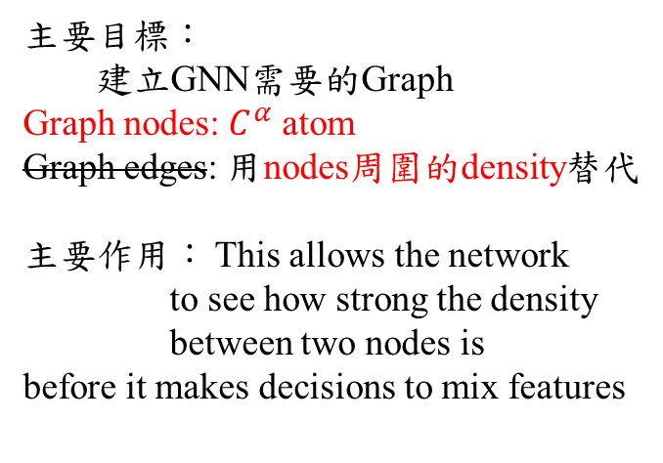
ModelAngelo Input: Cryo-EM map ($V∈ℝ^{N^{3}}$) + Sequence
CNN
Residue Segmentation
Cryo-EM Attention module + Sequence Attention module + Spatial Invariant Point
Attention module
主要目標：
建立GNN需要的Graph
Graph nodes: $C^{α}$ atom
Graph edges: 用nodes周圍的density替代
主要作用： This allows the network
to see how strong the density
between two nodes is
before it makes decisions to mix features
GNN
All-Atom Modelling
HMM
Post-processed

Slide 12
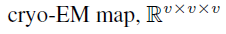
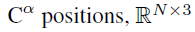
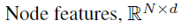
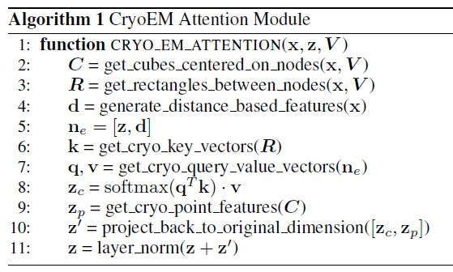
ModelAngelo Input: Cryo-EM map ($V∈ℝ^{N^{3}}$) + Sequence
CNN
Residue Segmentation
Cryo-EM Attention module + Sequence Attention module + Spatial Invariant Point
Attention module
GNN
All-Atom Modelling
HMM
Post-processed

Slide 13
ModelAngelo Input: Cryo-EM map ($V∈ℝ^{N^{3}}$) + Sequence
CNN
Residue Segmentation
Cryo-EM Attention module + Sequence Attention module + Spatial Invariant Point
Attention module
A pre-trained protein language model
Rives et al., 2021
Lin et al., 2022
主要目的：
取代MSA
GNN
All-Atom Modelling
HMM
Post-processed

Slide 14
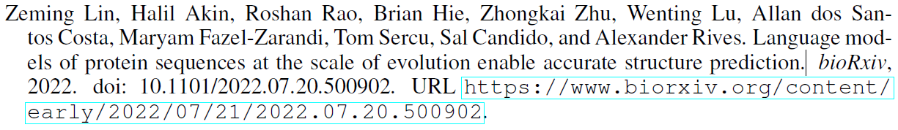
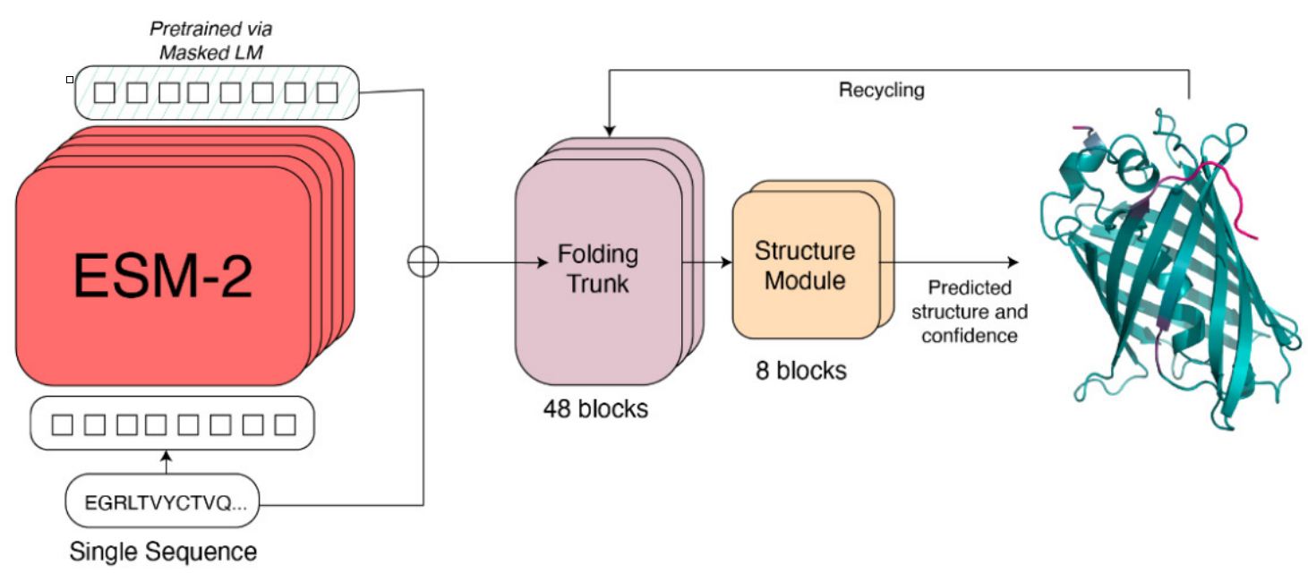
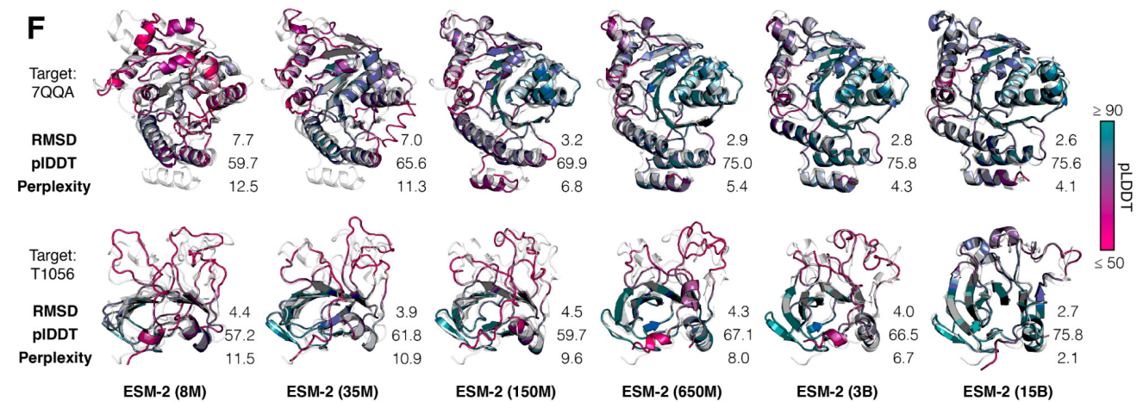
A pre-trained protein language model

Slide 15
ModelAngelo Input: Cryo-EM map ($V∈ℝ^{N^{3}}$) + Sequence
CNN
Residue Segmentation
Cryo-EM Attention module + Sequence Attention module + Spatial Invariant Point
Attention module
This is inspired by
the similarly named module in AlphaFold2
(Algorithm 22)
GNN
All-Atom Modelling
HMM
Post-processed

Slide 16
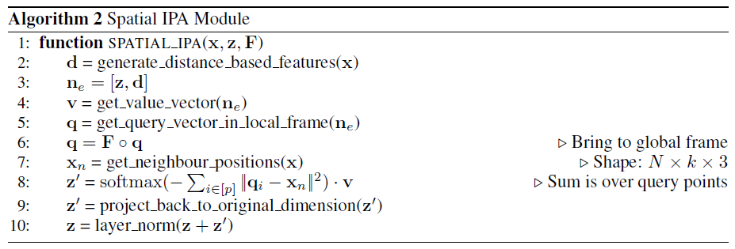
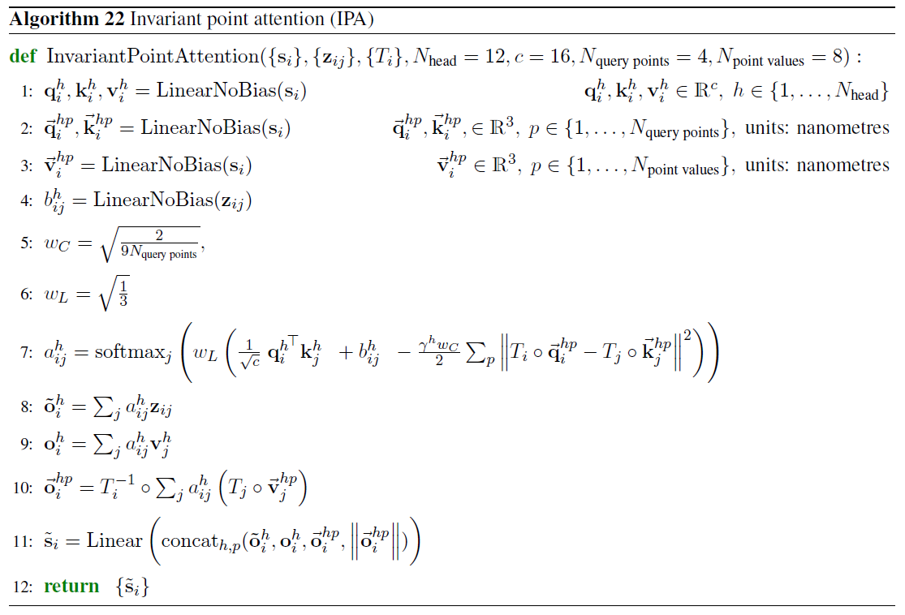
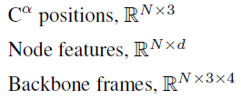
ModelAngelo Input: Cryo-EM map ($V∈ℝ^{N^{3}}$) + Sequence
CNN
Residue Segmentation
Cryo-EM Attention module + Sequence Attention module + Spatial Invariant Point
Attention module
Alphafold 2
GNN
All-Atom Modelling
HMM
Post-processed

Slide 17
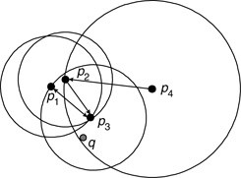
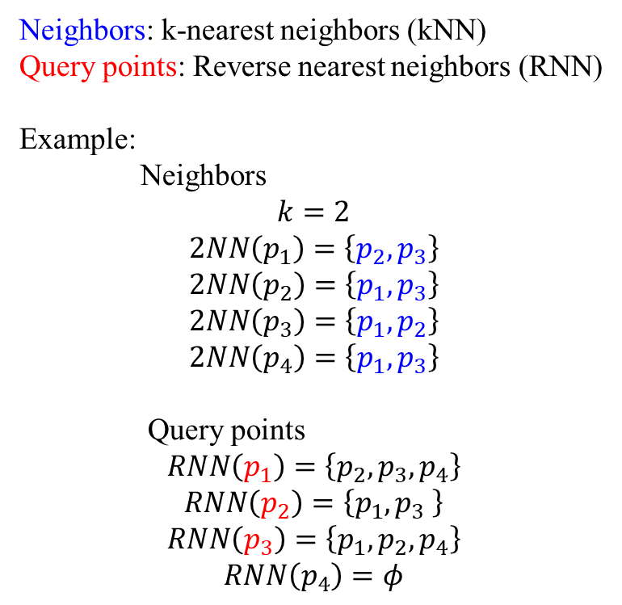
Query points and neighbors
 | ModelAngelo | Alphafold 2
Neighbors | 20 | 8
Query points | 4 | 4
Neighbors: k-nearest neighbors (kNN)
Query points: Reverse nearest neighbors (RNN)
Example:
Neighbors
$$k=2$$
$$2NN\left(p_{1}\right)=\left\{p_{2},p_{3}\right\}$$
$$2NN\left(p_{2}\right)=\left\{p_{1},p_{3}\right\}$$
$$2NN\left(p_{3}\right)=\left\{p_{1},p_{2}\right\}$$
$$2NN\left(p_{4}\right)=\left\{p_{1},p_{3}\right\}$$
Query points
$$RNN\left(p_{1}\right)=\left\{p_{2},p_{3},p_{4}\right\}$$
$$RNN\left(p_{2}\right)=\left\{p_{1},p_{3} \right\}$$
$$RNN\left(p_{3}\right)=\left\{p_{1},p_{2},p_{4}\right\}$$
$$RNN\left(p_{4}\right)=φ$$

Slide 18
ModelAngelo Input: Cryo-EM map ($V∈ℝ^{N^{3}}$) + Sequence
CNN
Residue Segmentation
Cryo-EM Attention module + Sequence Attention module + Spatial Invariant Point
Attention module
GNN
All-Atom Modelling
HMM
Post-processed
GNN Output
Backbone Frame module

Slide 19
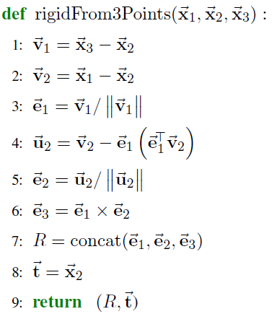
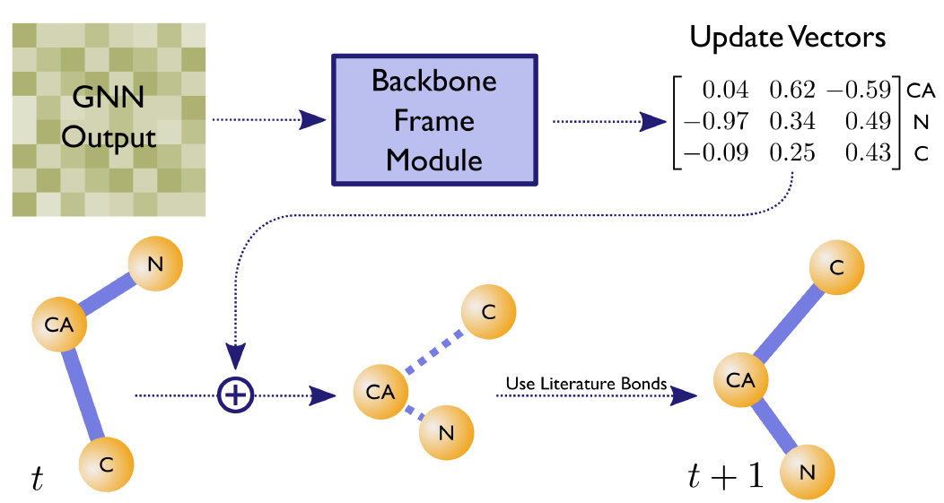
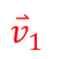
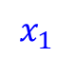
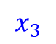
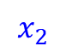

ModelAngelo Input: Cryo-EM map ($V∈ℝ^{N^{3}}$) + Sequence
CNN
Residue Segmentation
Cryo-EM Attention module + Sequence Attention module + Spatial Invariant Point
Attention module
Alphafold 2 (Algorithm 21)
GNN Output
GNN
All-Atom Modelling
Backbone Frame module
HMM
Post-processed
$${\overset{⃑}{v}}_{2}$$
$$x_{1}$$
$$x_{2}$$
$${\overset{⃑}{v}}_{1}$$
$$x_{3}$$

Slide 20

Losses
Summed over each step of the GNN,
though the last step has a higher weighting
One-step losses
Auxiliary losses
Only defined once for the final step of the GNN
The full-atom loss
The torsion angle loss
The sequence attention loss
The violation loss
$C^{α}$ RMSD loss
The backbone frame loss
The amino-acid classification loss
The edge classification loss
The local confidence score loss
The existence loss

Slide 21

ModelAngelo Input: Cryo-EM map ($V∈ℝ^{N^{3}}$) + Sequence
CNN
Residue Segmentation
To identify where individual residues are placed.（初始模型）
$$f_{θ}\left(V\right)=T$$
$C^{α}$ RMSD loss
$$ℒ_{C^{α}}=\frac{1}{N}\sum_{i=1}^{N}{RMSD\left(x_{i},f_{θ}\left(x_{i}+e_{i}\right)\right)}$$
GNN
All-Atom Modelling
Cryo-EM Attention module + Sequence Attention module + Spatial Invariant Point
Attention module
The full-atom loss
The torsion angle loss
HMM
Post-processed
Backbone Frame module
The backbone frame loss
The amino-acid classification loss
The local confidence score loss

Slide 22
ModelAngelo Input: Cryo-EM map ($V∈ℝ^{N^{3}}$) + Sequence
CNN
Residue Segmentation
combine the atomic coordinates predicted by the network
as well as the edge prediction probabilities as a heuristic to connect residues.
use the amino acid prediction probabilities to construct an HMM profile.
Based on the sequence search,
we also connect separate chains that should be connected depending on
both the matched sequence gap and
the proximity of the end of one chain and the beginning of the next.
GNN
All-Atom Modelling
HMM
Post-processed
Output:
The unpruned output, chains are built more or less as-is
from the output of the model, with minimal post-processing.
The pruned output seeks to remedy this by removing portions of the model
that do not have good matches to the sequence based on
the hidden Markov model alignment.

Slide 23

Results
DeepTracer
unpruned
unpruned
pruned
pruned
DeepTracer

Slide 24

Results

Slide 25

Results
High B-factor
The deposited model
DeepTracer
ModelAngelo
(Pruned model)
Low B-factor

Slide 26

PDB | 7qlu
Method | DeepTracer | ModelAngelo Pruned | ModelAngelo Unpruned
Resolution | 2.7 | 2.7 | 2.7
Backbone RMSD | 0.546 | 0.268 | 0.273
$C^{α}$ recall | 99.3 | 99.6 | 100.0
$C^{α}$ precision | 99.2 | 99.3 | 97.7
lDDT | 96.2 | 99.2 | 99.1
Sequence match | 99.2 | 99.9 | 99.6
Sequence recall | 98.5 | 99.6 | 99.6

Slide 27


PDB | 7ode
Method | DeepTracer | ModelAngelo Pruned | ModelAngelo Unpruned
Resolution | 2.84 | 2.84 | 2.84
Backbone RMSD | 0.960 | 0.418 | 0.549
$C^{α}$ recall | 66.6 | 81.5 | 96.9
$C^{α}$ precision | 29.0 | 99.2 | 93.5
lDDT | 93.1 | 96.7 | 94.6
Sequence match | 69.9 | 95.7 | 84.2
Sequence recall | 46.5 | 78.0 | 81.7
PDB | 7rzy
Method | DeepTracer | ModelAngelo Pruned | ModelAngelo Unpruned
Resolution | 3.5 | 3.5 | 3.5
Backbone RMSD | 1.544 | 0.746 | 1.122
$C^{α}$ recall | 71.4 | 47.2 | 95.3
$C^{α}$ precision | 94.2 | 99.2 | 85.9
lDDT | 79.7 | 90.1 | 82.8
Sequence match | 17.9 | 97.2 | 57.2
Sequence recall | 12.8 | 45.8 | 54.5

Slide 28
The End

